Slide 1

EOC (EMERGENCY Operation Center)
Team Members:
Pavan Kumar Reddy Byreddy
Samanth Gourineni
Sushma Rani Reddy Aleti
Anvesh Rokanlawar
Meghna Reddy Kunta
Abhishek telugu

Slide 2
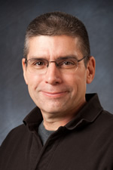
Client:
Dr. MARK CORSON
Department Chair of Natural Science Department, Northwest Missouri State University
Email: mcorson@nwmissouri.edu
660-562-1672

Slide 3


Problem
3
Manually keeping track of the incidents and reports over the paper.
Creates a mess up situation

Slide 4
Goals
Able to create incident and create reports for the incident.
Able to retrieve past incidents.
Keep track of the resources.

Slide 5
Project Requirements
Login and Signup functionalities
Create, View, Edit and Close incidents
Closed incidents
Create and View Reports
Create and View resources
Assign incidents

Slide 6
Methodology
Agile Methodology
Customer satisfaction through early and continuous software delivery
Accommodate changing requirements throughout the development process
Frequent delivery of working software
Support, trust, and motivate the people involved
Enable face-to-face interactions
Regular reflections on how to become more effective

Slide 7
Component Diagram

Slide 8
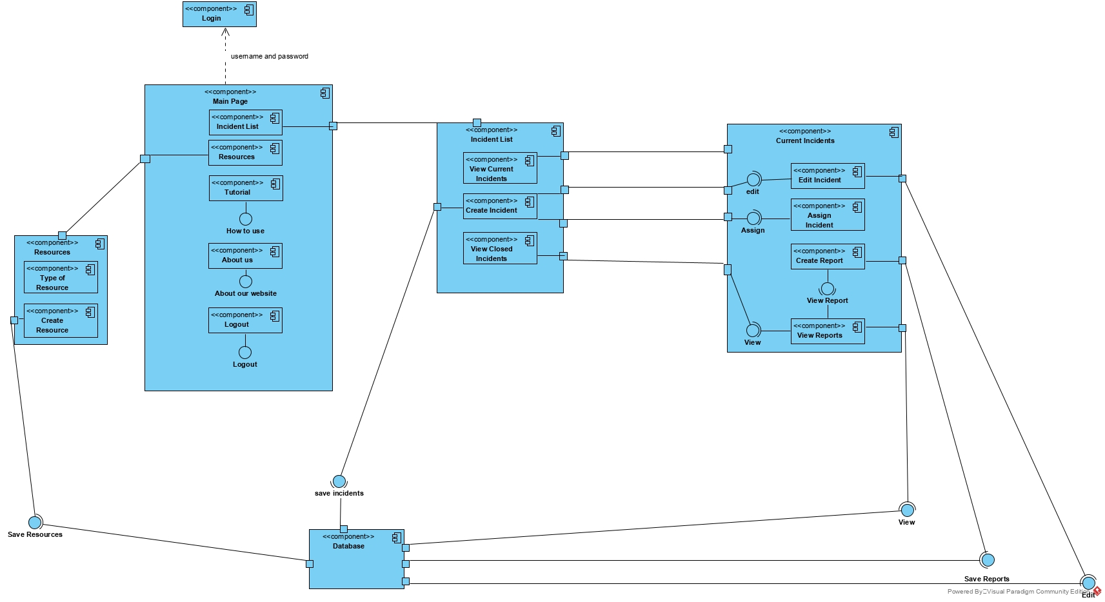

Slide 9
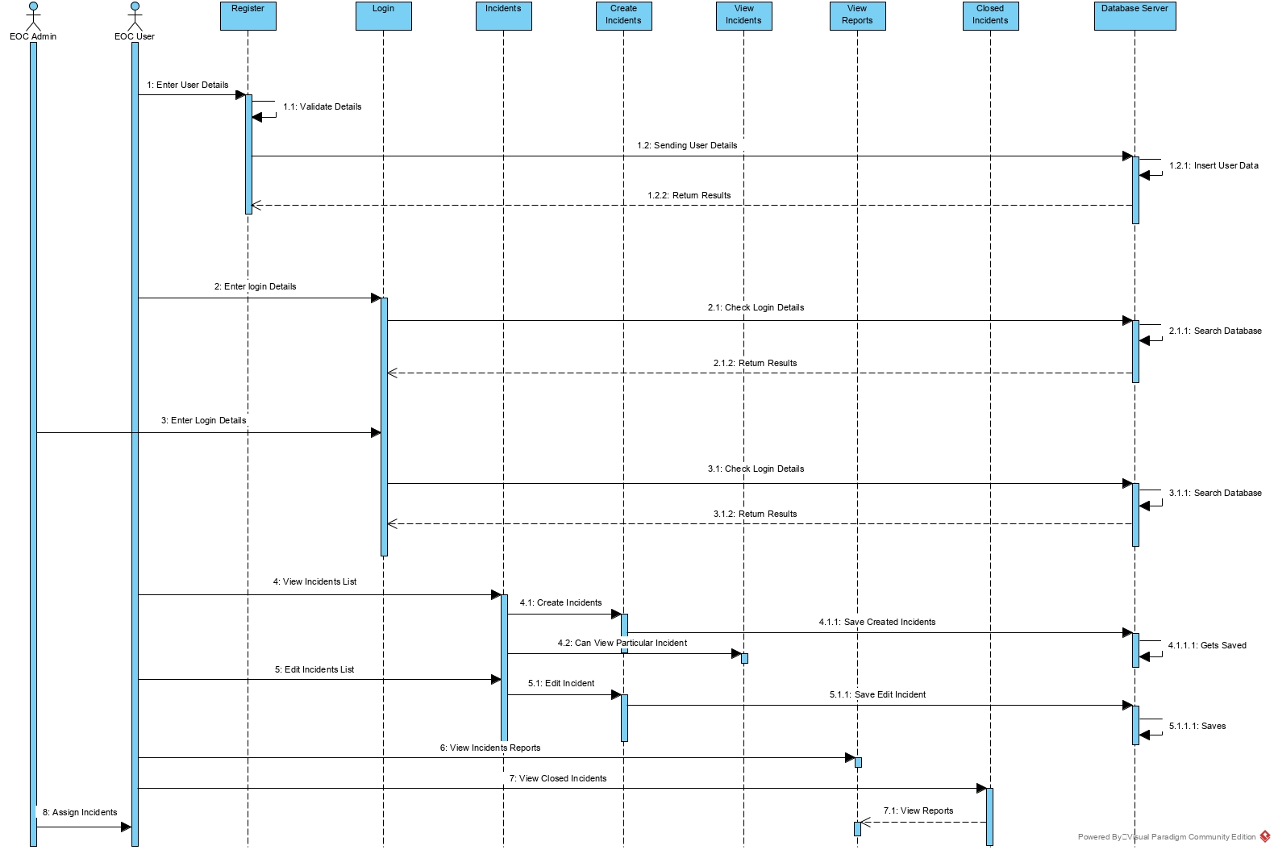
Sequence Diagram (Incidents)

Slide 10
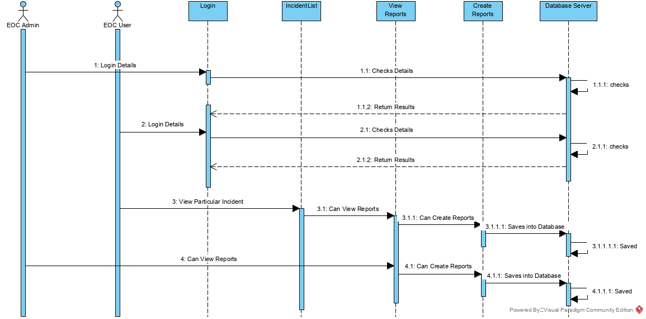
Sequence Diagram (Reports)

Slide 11
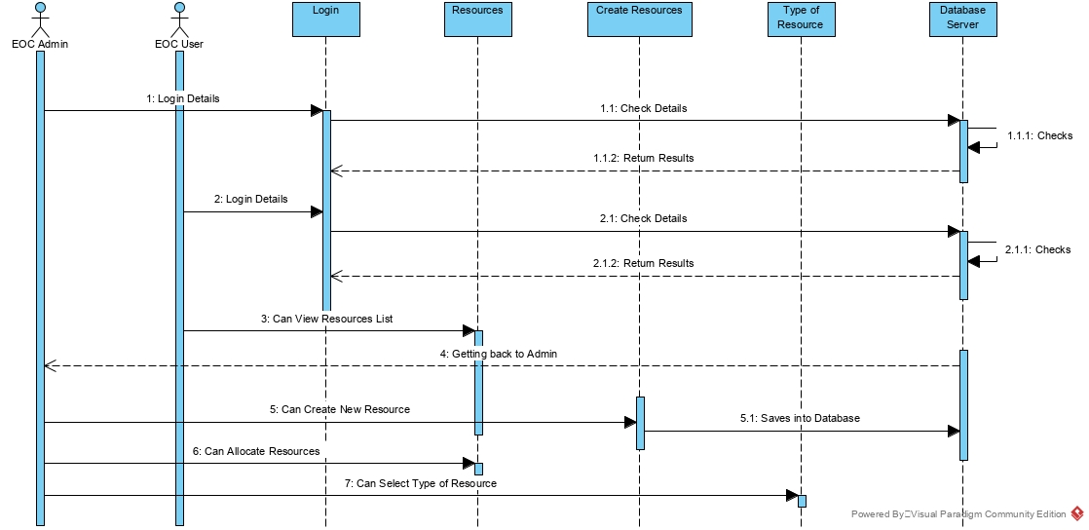
Sequence Diagram (Resources)

Slide 12
Tools Used
React JS
Node JS
Mongodb
GIT
Heroku
Github
Postman

Slide 13
Pending Tasks
Navigation after closing report
Making assigned resources visible in incident page
Edit & Delete Resource

Slide 14
Things Learned
Communication
Planning skills
Time management
Negotiation Skills
Team work

Slide 15
Any questions ???

Slide 16
Thank you ☺ ☺ ☺

